Slide 1

Celebrate Urban Birds
Focal Species

Slide 2

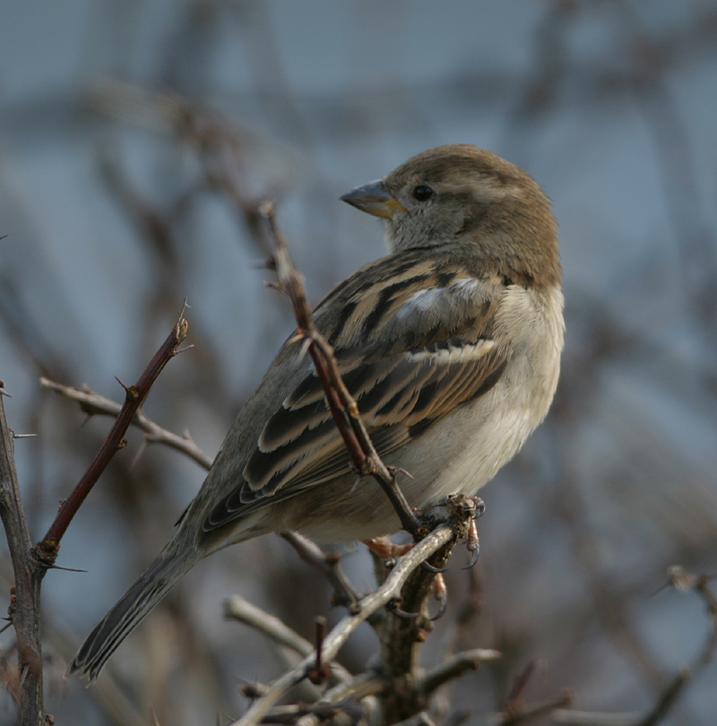
Accurate Data are Important!
Look at the bird!

Slide 3
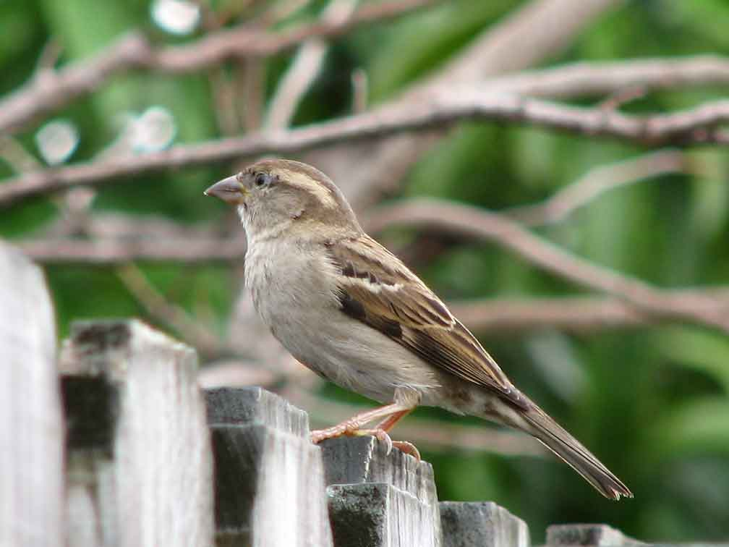
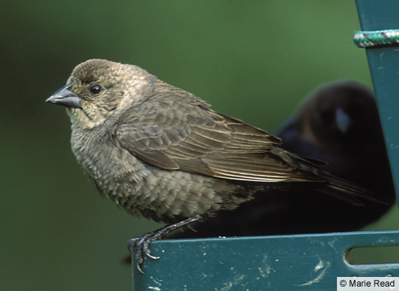
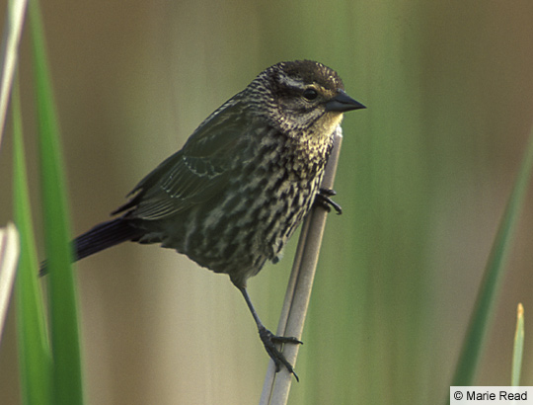
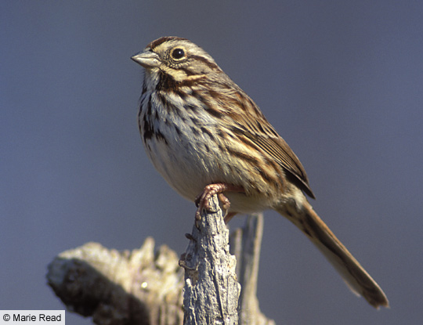
  Where did I see the bird?
  Does it remind me of any other birds?
  Size & Shape
  Color Pattern
  Behavior
  Habitat
  Field Marks
  Songs & Calls
Notes:
Dark birds look bigger on cloudy days
What time of year is it?
Female House Sparrow: eye stripe, Un-streaked breast, Streaked back.
Female red winged blackbird: Grayish brown overall, with blurry streaks on chest and sides. Face all brown, with no eyestripe.
Song Sparrow: Streaks on breast converge to spot, whitish eyebrow, Dark stripes border white on throat
Cowbird: Entirely grayish brown. Chest with dull streaks. Throat whitish. Suggestion of faint pale eyestripe. Bill gray.

Slide 4


www.AllAboutBirds.org
Notes:
This is a good resource to learn about birds: allaboutbirds.org

Slide 5

Youtube demo: https://www.youtube.com/watch?v=OkH11ZiIL9E#t=38
Notes:
Your creativity, your methods, what worked…what didn’t. Teach others…

Slide 6

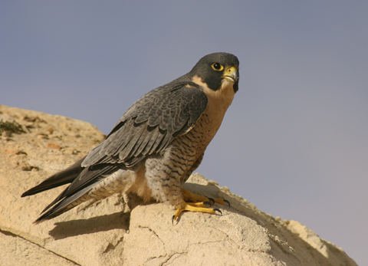
Peregrine Falcon
Halcón Peregrino
By iStockPhoto
Notes:
Identification tips…look up! You’ll probably see this bird in the air or possibly high up on the ledge of a tall building in a big city.
* Large falcon, medium-sized hawk.
* Black mustache mark on face.
* Long pointed wings.
Cool Fact:
The name "peregrine" means wanderer or traveler. The Peregrine Falcon has one of the longest migrations of any North American bird. Some falcons may travel 15,500 miles in a year.
Sound:
Alarm call is a loud series of harsh "kak, kak, kak."
Habitat:
It can nest on ledges on cliffs or skyscrapers in cities.
Food:
Mostly live birds.
Did you know?
The Peregrine Falcon can reach up to 200 miles per hour when it dives for prey. It is the fastest bird in the world.
It was nearly exterminated from eastern North America by pesticide poisoning in the middle 20th century, but restoration efforts have made it a regular, if still uncommon sight in many large cities.

Slide 7
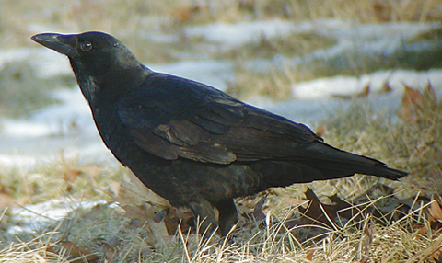
American Crow
Cuervo Americano
By Kevin McGowan
Notes:
Identification tips…look in trees, on the ground, and listen for the voice of the crow, who has a lot to say! The American Crow is a big black bird with…
* dark brown eyes
* black legs
* All feathers black glossed with violet.
Cool Fact:
To eat road kill, crows have to wait for something else to tear open the body or for the body to decompose and soften, since a crow’s beak isn’t usually strong enough to tear open the dead animal’s skin.
Sound:
Call is a harsh “caw”. Also a variety of rattles, coos, and clear notes. Crows are always watching for animals they consider predators, and will sound the alarm if they see a hawk or owl.
Habitat:
Lives in farmland, towns, and suburbs. Needs open ground for feeding and trees for nesting, refuge, roosting. Crows often gather in big groups with thousands of birds in the wintertime.
Food:
Insects, small birds and mammals, eggs, nestlings, grain, seeds, fruit, dead animals (carrion), garbage, crows are omnivores…they like to eat almost everything!
Did you know?
Young crows may stay with their parents for years until they can find a home of their own. The young crows help their parents guard their territories and raise new young.
American Crows congregate in large numbers in winter to sleep in communal roosts. These roosts can be a few hundred, several thousand, or even up to two million crows. Some roosts have been forming in the same general area for well over 100 years. In the last few decades some of these roosts have moved into urban areas where the noise and mess cause conflicts with people.

Slide 8
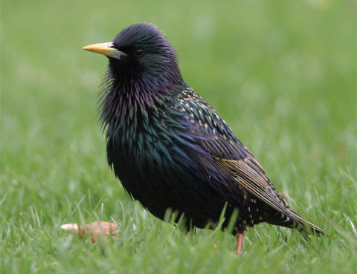
European Starling
Estornino Europeo
By Sam Crowe
Notes:
Identification tips: a small but good-sized black bird…larger than a sparrow but smaller than a crow
Short, square-tipped tail.
Pointed, triangular wings.
Long pointed bill, yellow in breeding season.
Shimmering green and purple feathers in spring.
Starlike pattern on back
Cool fact:
Migrating flocks of European Starlings consisting of 100,000 birds are not uncommon. They nest in cavities (holes in trees, buildings, and nest boxes) and might destroy eggs and kill nestlings of native birds (like bluebirds and woodpeckers) to use their nesting sites.
Sound:
Rattles and whistled notes; imitates the sounds of other birds and animals including humans. Amazing vocalist and mimic.
Habitat:
Cities, towns, suburbs, and farmland.
Food:
Berries, insects and other invertebrates, fruits, grains, seeds, and garbage.
Did you know?
The European Starling is not native to North America. In 1890-1892, a group that wanted to bring all the birds mentioned in Shakepeare’s works to North America released 100 birds in Central Park and now there are more than 200 million European Starlings in North America!

Slide 9
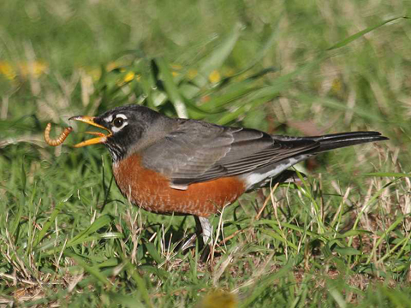
American Robin
Mirlo Primavera
By Errol Taskin
Notes:
American Robin
Identification tips: larger than a sparrow, smaller than a crow, with dark back and reddish breast
Back and wings gray.
Underparts red.
Dark head with white eye crescents.
Compared with males, females have paler heads that contrast less with the gray back.
Cool facts:
Hundreds of thousands of American Robins can gather in a single winter roost. In summer, females sleep on the nests and males congregate in roosts. As young robins become independent, they join the males in the roost. Female adults go to the roosts only after they have finished nesting.
Sound:
Song is a musical whistled, "cheerily, cheer up, cheer up, cheerily, cheer up." Call is a sharp "chup.”
Habitat:
Cities, towns, suburbs; gardens, parks, woodlands
Food:
Earthworms and fruit. Robins eat different types of food depending on the time of year and time of day; they eat earthworms early in the day and more fruit later in the day. Because the robin forages largely on lawns, it is vulnerable to pesticide poisoning and their health can be an important indicator of chemical pollution.
Did you know?
On average only 40 percent of American Robin nests successfully produce young. Only 25 percent of those young survive to November.
Only about half of the robins alive in any year will make it to the next, but a lucky and smart robin can live to be 14 years old.

Slide 10
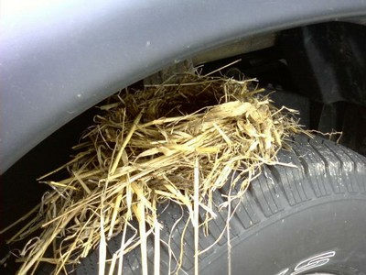
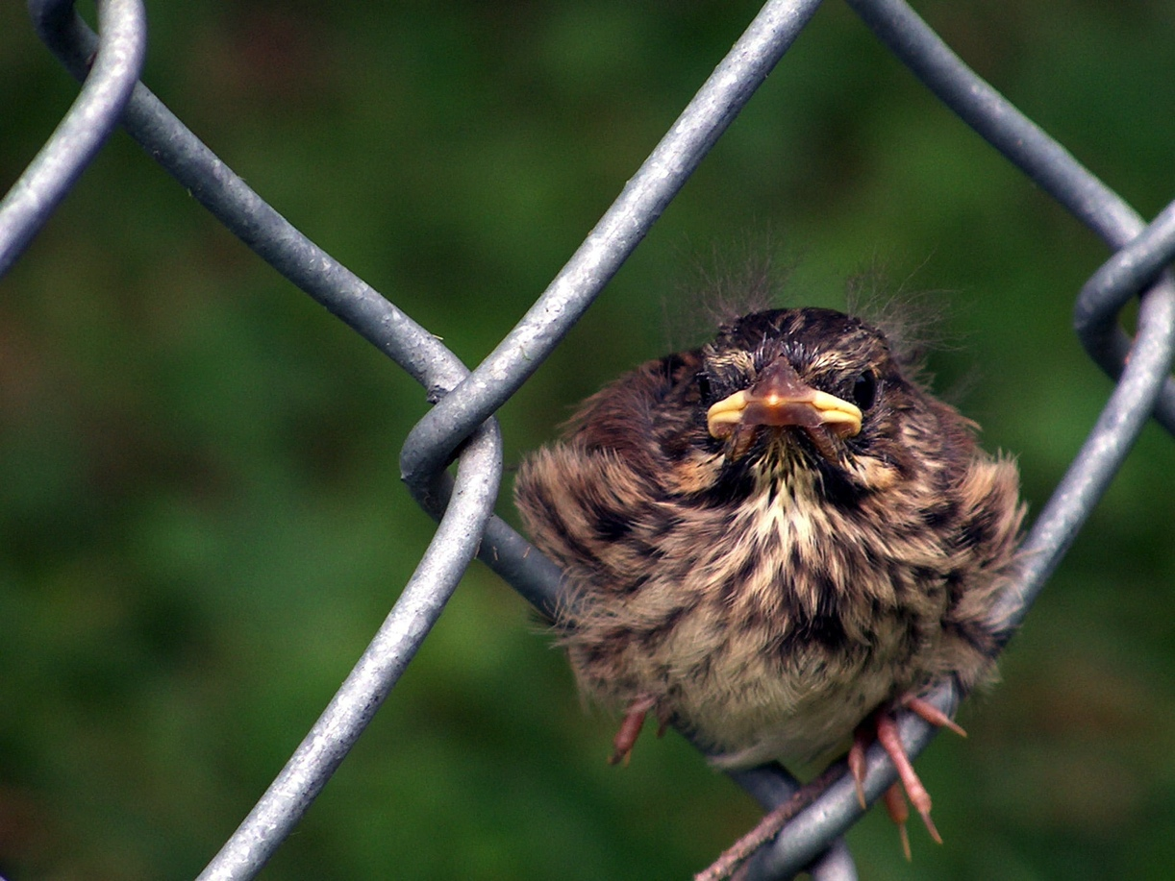
American Robin
(nest and juvenile)
Notes:
Photo of Juvenile American Robin by CUBs participant Jennifer Rowe, Brevard, North Carolina
Photo of nest on tire by Jeff Mills
Identification tips: look for baby robins in spring and maybe in summer if parents are raising successive broods.
Juvenile looks somewhat similar to adult, but has black spotting on underparts, pale spotting on upperparts, white throat, and paler head. Younger babies look ‘funny’ with tufts of baby feathers on their head, yellow beak that looks too big for their head, and awkward attempts to fly.
A robin nest is an open cup of grass and twigs held together with a thick layer of mud, lined with fine dry grass. Nest is usually relatively low in a tree on a firm branch with dense foliage, but can be placed from ground to treetop, on lights next to doorways, on top of tires on parked cars, and on flat surfaces.
Cool facts:
Female does not usually remain on the nest at night after the first week
Babies fledge, (leave the nest) when they are about thirteen days old. They still can’t fly, and are vulnerable on the ground. The parents follow them and feed them. The fledglings spend 10-15 days in low cover, dependent on their parents for food. By the time they are 4 weeks old the young can take care of themselves.

Slide 11
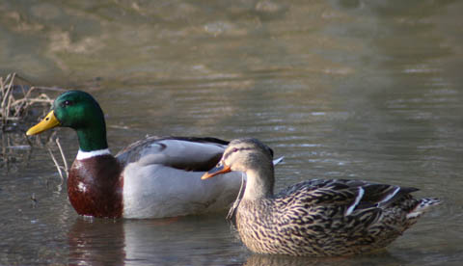
Mallard
Pato de Collar
By Deanna Taylor
Notes:
Identification tips: This is the duck you are most likely to see in urban and suburban settings. Male and female look very different though!
Male has shiny, or iridescent green head, rusty chest, and gray body.
Female is plain mottled brown, and blends in with grasses and nest.
Cool Fact:
Mallards find their mates long before the spring breeding season. They pair up in the fall, but they court each other throughout the winter. Only the female incubates the eggs and takes care of the ducklings.
Sound:
Female gives loud series of quacks. Male makes softer, rasping "rab". Wings whistle in flight.
Habitat:
Found in all wetland habitats, cities, farms.
Food:
Insects and larvae, aquatic invertebrates, seeds, acorns, aquatic vegetation, grain.
Did you know?
Mallards freeze or pretend to be dead when captured by a fox. Sometimes the confused fox loosens its grip and allows the Mallard to escape.

Slide 12
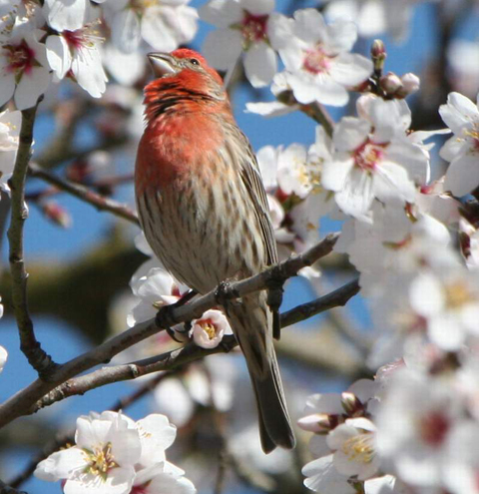
House Finch
Pinzón Mexicano
by Tiny Gehrke
by Tiny Gehrke
Notes:
Identification tip: small bird with a bit of pink color on head and chest…smaller than a robin
Male bright red on head, chest, and rump
Bill short and thick, with rounded top edge.
Two thin white wingbars.
Cool fact:
The poop of nestling House Finches is enclosed in a thin sac called a fecal sac (this is true for most birds). The parents eat the fecal sacs of the nestlings for about the first five days. When most parent songbirds stop eating the sacs, they carry the sacs away from the nest. House Finch parents don’t do this and the sacs build up around the rim of the nest.
Sound:
Song is a hoarse warble that goes up and down rapidly. Call is a sharp "cheep."
Habitat:
House Finch is bird of the cities and suburbs, and comes readily to feeders. It also breeds in close association with people, and often chooses a hanging plant in which to put its nest.
Food:
Buds, seeds, and fruits.
Did you know?
The red or yellow color of a male House Finch comes from pigments that it gets in its food. The more pigment in the food, the redder the male. Females prefer to mate with the reddest male they can find..

Slide 13
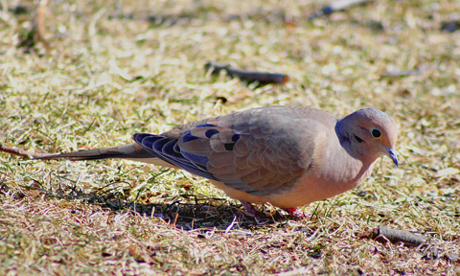
Mourning Dove
Paloma Huilota
by Maria Corcacas
Notes:
ID Tip: often looking for food on the ground, under feeders, or sitting on telephone wires.
* Small head.
* Long, pointed tail.
* Light brown body.
* Tail with white outer edges.
Cool fact:
On hot rainy days, Mourning Doves may lean forward, hold up their wings, and fluff themselves up allowing water to get into their feathers. In a cold rain or if they don't want to get wet, they hold their heads high and flatten their feathers and the water flows off.
Sound:
Song is a mournful “Ocoo-OOH, Ooo-Ooo-OooÓ”. Wings whistle in flight.
Habitat:
Found almost everywhere. Prefers open areas, farmland, open woods, deserts, forest edges, cities and suburbs.
Food:
Grains and seeds; occasionally eats snails, slugs, insects. Grit is an important part of their diet.
Did you know?
Mourning Doves are still hunted throughout most North America, yet they remain among the 10 most abundant birds in the United States.

Slide 14
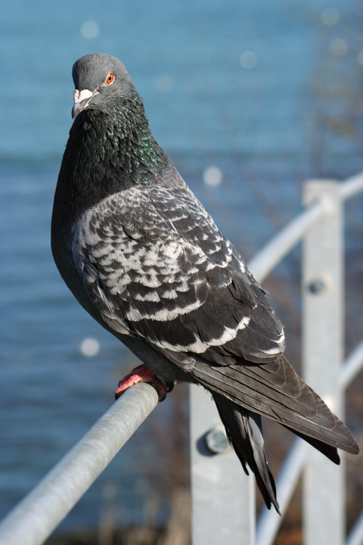
Rock Pigeon
Paloma Doméstica
By iStockPhoto
Notes:
ID Tip: larger and comes in more colors than a Mourning Dove.
Color variable, but Blue-bar color morph is most common…look for the bluish bar across the wings.
White rump.
Rounded tail, usually with dark tip.
Wings broad with moderately pointed wingtips.
Males often have iridescent neck and throat
Cool Fact:
Both male and female Rock Pigeons produce “pigeon milk” in their crops which they feed to their hatchlings.
Sound:
“Coo roo-c’too-coo”
Habitat:
Found in cities, suburbs, and farmlands
Food:
Seeds, fruits, grain, and human leftovers
Did you know?
Homing Pigeons are the same species as ordinary city pigeons. They can find their way home from hundreds of miles away, and have been used in war to deliver messages across enemy lines.

Slide 15
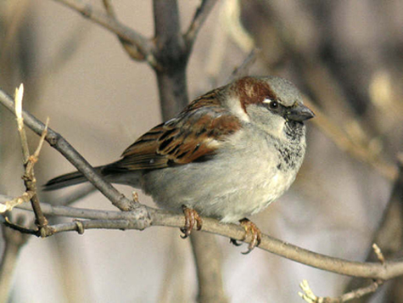
House Sparrow
Gorrión Doméstico
by Raymond Belhumeur
Notes:
ID tips: small bird, about the same size as the House Finch
Small, stocky songbird.
Bill thick.
Legs short.
Chest unstreaked.
Wingbars.
Male with black throat and white cheeks, black is darker in breeding plumage, Female has faint eyestripe
Cool Fact:
100 House Sparrows were bought by Mr. Nicolas Pike for $200 from England and released in Brooklyn, NY, in the fall the 1851 and the spring 1852. By 1900 House Sparrows had spread throughout most of the U.S. and into Canada.
Sound”
Call is a metallic "cheep, chirrup." Song is a series of cheeps.
Habitat:
Cities, towns, suburbs, farmland; near humans.
Food:
Seeds, grain, and insects.
Did you know?
House Sparrows can swim if they are forced to! An adult swam to shore when escaping a hawk. Nestlings that have fallen into the water from their nests can also swim to land.

Slide 16
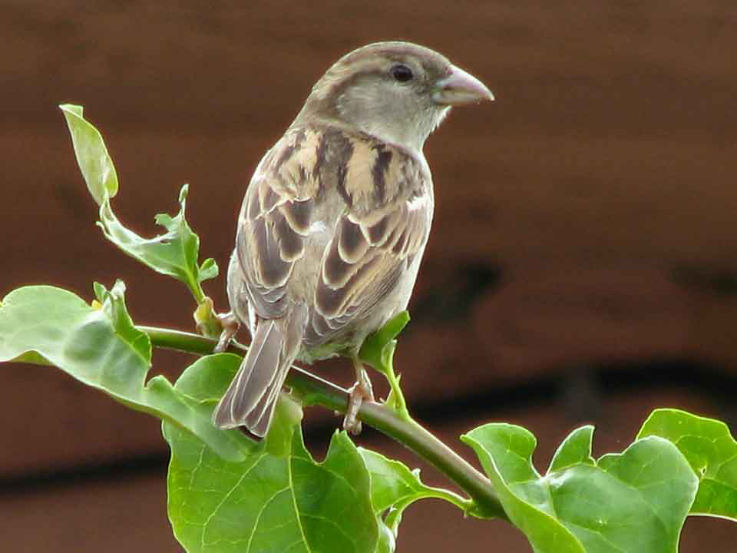
House Sparrow
(female)
By Marian Mendez
Notes:
ID tips: you see her all the time and never notice her!
frequently seen with male House Sparrow!
gray-brown crown and pale streak behind eye.
unmarked throat and breast, plain gray-brown
short wings and tail, light-colored but stout bill
Cool Fact:
Can bathe in water or dust.
House Sparrows have been observed attacking as many as 70 other species of birds, esp to steal or defend a nest cavity, including other House Sparrows, Eastern Bluebirds, Tree Swallows, and Purple Martins.
Female House Sparrows prefer male House Sparrows with darker, larger black bibs.
Habitat:
Birds often congregate at dawn and dusk in densely leaved bushes…listen for a lot of cheeping!

Slide 17
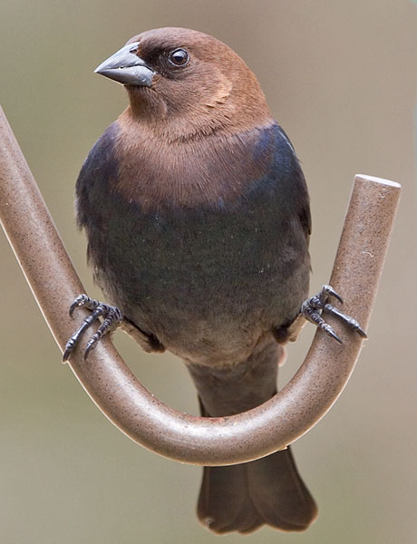
Brown-headed Cowbird
Vaquero de Cabeza Café
By Judy Howle
Notes:
ID Tips: (Now you can see the brown head of the Brown-headed Cowbird!)
* Male shiny black with brown head and neck.
This is a common bird across most of North America, but numbers are declining in most areas. Its habit of nest parasitism can cause the decline of species with small populations, such as Kirtland's Warbler and Black-capped Vireo.
American Robins and Gray Catbirds will throw the cowbird egg out of the nest.
Cowbirds like the ‘edge’ of forest area to nest in…somewhere right next to open space where they can find food. If you see birds pecking and investigating right near where horses or cows are eating grass, that’s probably a cowbird.

Slide 18
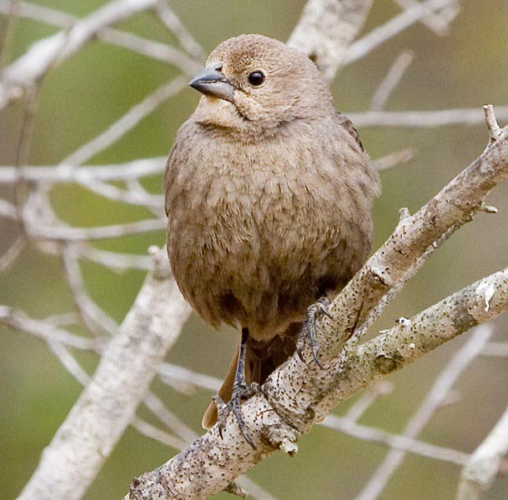
Brown-headed Cowbird
(female)
by Judy Howle
Notes:
ID Tips: bigger than a sparrow, often seen with groups of blackbirds
* Medium-sized songbird.
* Medium-long tail.
* Bill stout and pointed.
* Female dull gray-brown.
Cowbirds can be considered a pest bird, but are our only native North American parasitic nester. Used to be in the Great Plains where they ate the insects in the grass near the wandering bison, but now moving into east because of larger areas of open cleared land. So they are moving from farmland into the suburbs!
May migrate short distances, often seen in flocks with Common Grackles, European Starlings, Red-winged Blackbirds, or sometimes American Robins.
Food:
Eats seeds (mostly from weeds) and insects found on the ground. Females sometimes get calcium by eating snail shells.
Cool Facts:
Cowbirds are incapable of nesting, incubating or raising their own chicks. Instead, they lay their eggs in the nests of other bird species, who then raise the young cowbirds.
Female may lay as many 40 eggs per year…where? In other birds’ nests, especially warblers, Oven Birds, and Song Sparrows.
When a cowbird lays an egg in another bird's nest (called the "host" bird), it usually tosses out one of the host's eggs. If a host bird then removes a cowbird egg, the cowbird may retaliate by returning and destroying all of the host's remaining eggs.
Many birds have evolved ways of rejecting cowbird eggs. The Yellow Warbler, for example, will build a new nest lining over the cowbird's eggs if she finds them in her nest.
Sound:
Song is a low “glug, glug” followed by slurred whistles that end on a very high pitch.

Slide 19
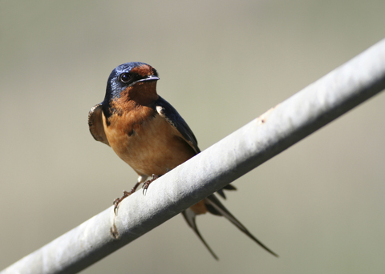
Barn Swallow
Golondrina Tijereta
By iStockPhoto
Notes:
ID tips: small, graceful, very talented flying bird…often swooping over water or grassy areas to catch flying bugs, or perching on wires nearby nests
small slender songbird
long and forked tail
upperparts steely iridescent blue
reddish belly on males; females have whitish belly
Cool Facts:
Barn Swallows originally nested in caves, but now the swallow nests almost exclusively on man-made structures like barns and underneath bridges
The Barn Swallow is the most abundant and widely distributed swallow species in the world. Barn Swallows nest and breed in North America but spend winter in Central and South America. They might travel as far as 120 miles in a day during migration. Migration might take a couple of months, either going south in the fall or north in the spring.
Sound:
A twitter series of squeaky notes, often with dry rattle in the middle.
Habitat:
Open areas with structures for nesting. Nest looks like half a cup, made of daubs of mud, fastened to eaves of buildings.
Food:
Flying insects.
Did you know?
Females prefer to mate with males that have the longest and most symmetrical tails, also those males with the reddest breasts.
When feeding their nestlings, swallows carry several insects at a time to the nest, packing them together into a ball that they carry in their throats. A pair of swallows may bring up to 400 separate meals per day to their nestlings.

Slide 20
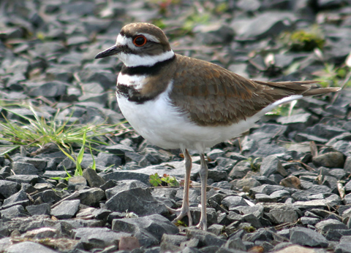
Killdeer
Chorlo Tildío
by Paul Rentz
Notes:
ID tips: look for them on the ground, in gravel by the side of the road, parking lots, driveways, flat roofs
medium-sized shorebird
legs moderately long
short neck
brown back
white underparts with two black bands on chest.
Cool Fact:
Killdeer are skilled actors and will try to lure potential predators away from their nests by pretending to have a broken-wing. They will also practice "false-brooding" if a predator is nearby, where the adult will settle down as if to brood at a site where there are no eggs or chicks. Nests are built right on stones and are very hard to see.
Gravel rooftops attract Killdeer for nesting, but they can be dangerous. Chicks may be unable to leave a roof because of high parapets and screened drain openings. When adults lure chicks off the roof, the chicks may die from the fall. However, some chicks have been observed leaping from a seven-story building and surviving.
Because Killdeer commonly use gravel rooftops and parking lots for their nesting sites, they frequently have to work to keep their eggs cool. If the eggs get too warm, an adult will stand over them to shade them from the sun. If temperatures increase, Killdeer will dip their breast-feathers in nearby water and cool the eggs by wetting or ‘air-conditioning’ them.
Sound:
Call is a loud piercing ‘kill-deer.’
Habitat:
Found in open grassy areas and sandbars, gravel parking lots, rooftops, driveways, by the side of roads.
Food:
Mostly insects, also earthworms and snails.
Did you know?
Killdeer are willing to live and nest close to people. Because they live so close to people, however, they are vulnerable to pesticide poisoning and collisions with cars and buildings.

Slide 21
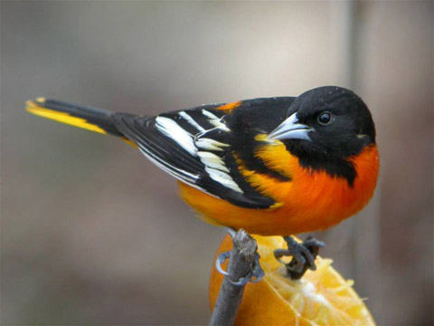
Baltimore Oriole
Bolsero de Baltimore
By Victor Loewen
Notes:
ID tips: about the size of an American Robin
* medium-sized songbird.
* male is brilliant orange with black head.
* often found singing from the top of a tall tree…(see silhouette poster)
Cool Fact:
With its bright orange and black plumage, the Baltimore Oriole's arrival is eagerly awaited by birders each spring migration. It prefers open areas with tall trees and is common in parks and suburban areas. Also look for it along woodland edges and open areas with scattered trees
Sound:
Song is a series of rich whistled notes interspersed with rattles.
Food:
Caterpillars, fruits, insects, spiders, and nectar.
Did you know?
Young male Baltimore Orioles don’t get their adult plumage until the fall of their second year. Instead, they look like females. Some first-year males succeed in attracting a mate and nest successfully.

Slide 22
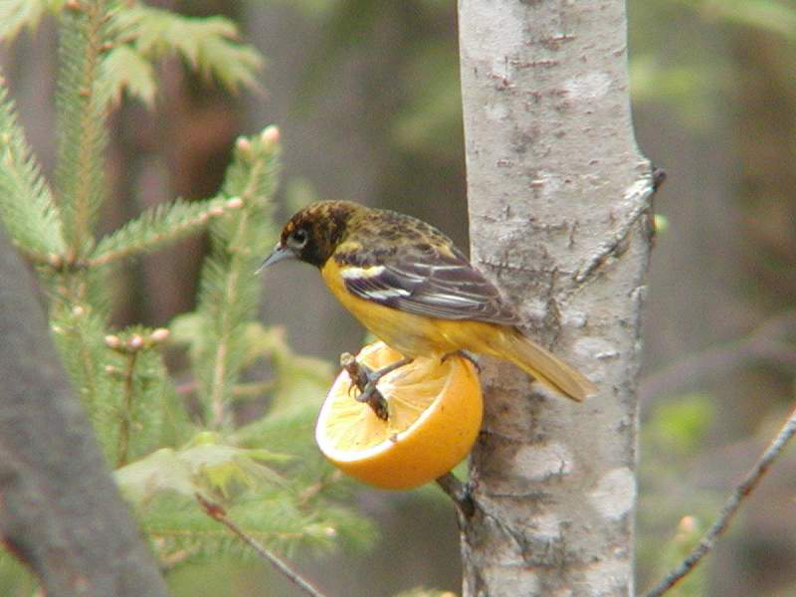
Baltimore Oriole (female)
By Victor Loewen
Notes:
ID tip: female Baltimore Oriole duller and without the solid black hood that the male has…
look for long tails and long pointed bills
female might be near the distinctive hanging, woven nest
if you put out grape jelly or half an orange, chances are the bird that comes and eats will be a Baltimore Oriole…they love fruit.
Most Baltimore Orioles migrate to the tropics in Central America.
Populations show a slight decrease and should be counted carefully.

Slide 23
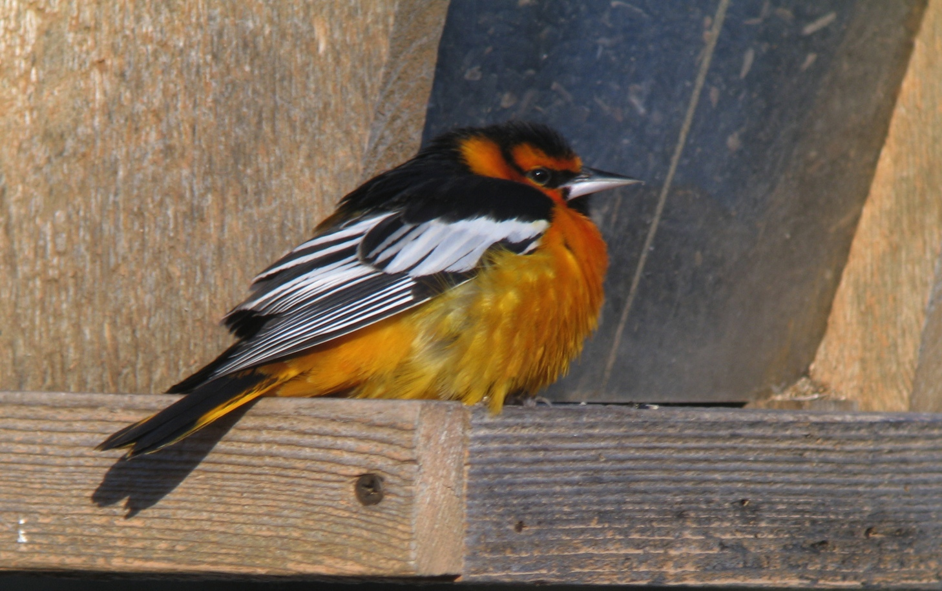
Bullock’s Oriole
Bolsero de Bullock
By Matt Hysell
Notes:
There is a special challenge to remember when you watch for orioles.…if you are in the East you will look for the Baltimore Oriole and if you are in the western part of the country you will look for the Bullock’s Oriole. If you are in the middle area where you might see either kind it can be tricky and exciting, because you might even see a hybrid (combination of Baltimore and Bullock’s) It will be easier to see the difference between the male birds…the Bullock’s Oriole male has orange on his head with a black eye stripe and the lower part of his beak is pale. In his first year, he will develop a black line down his throat as he gets older.

Slide 24
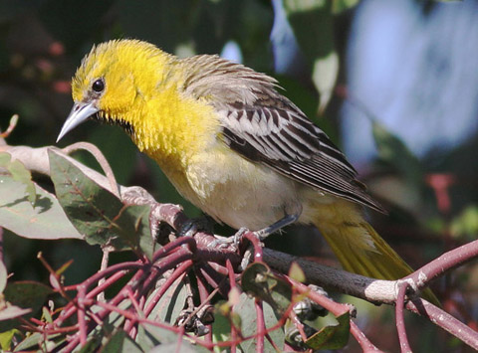
Bullock’s Oriole (female)
By Tom Grey
Notes:
The female Bullock’s Oriole would be seen in the western part of the country, and has a more yellow head than the female Baltimore Oriole, who has her brightest color on her breast. When you are filling out the data sheet you will have to specify whether you would be looking for Baltimore or Bullock’s Oriole, based on your location in the eastern or western part of the US, and then say ‘yes, no, or unsure’ as to whether you saw one.

Slide 25
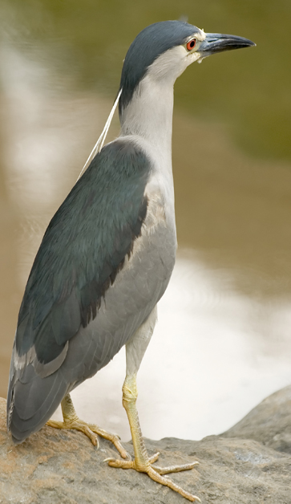
Black-crowned
Night-Heron
Pedrete de Corona Negra
By iStockPhoto
Notes:
ID tip: look near water! This is a pretty big bird…bigger than an American Crow!
medium-sized, stocky heron.
short neck and thick black bill.
black cap and back.
gray wings
white belly
Cool Facts:
Young Black-crowned Night Herons may aggressively defend their nests, regurgitating and defecating (pooping) on human intruders, squawking with wings outstretched and beak wide open!
When feeding Black-crowned Night Herons dive feet first, or plunge headfirst into the water. They generally sleep during day except when they have to find food for their young in daylight hours.
Adult Black-crowned Night-Herons don’t distinguish between their own young and those from other nests, and will care for chicks that don’t belong to them.
Sound:
Call is a loud, harsh squawk.
Habitat:
Marshes, swamps, streams, ponds, lakes, and fields.
Food:
Black-crowned Night Heron eats a wide variety of foods. Earthworms, insects, fish, snakes, rodents, eggs, plants, garbage, and more.

Slide 26
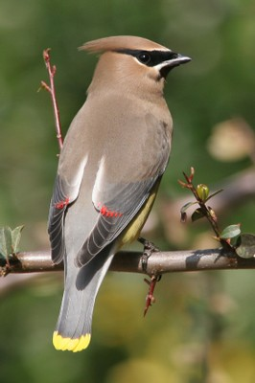
Cedar Waxwing
Ampelis Chinito
By "Jupiter Saturn"
Notes:
ID tips: about the size of an American Robin and looks like it’s wearing a mask!
Medium-sized songbird.
Gray-brown overall.
Crest on top of head.
Black mask edged in white.
Yellow or orange tips on tail feathers
Waxy tips on the end of some of the wing feathers
Cool Fact:
The Cedar Waxwing depends on fruit for food and can survive on fruit alone for several months. Because of its dependence on fruit it breeds late in the season and leads a nomadic life, looking for more fruit!
Sound:
Calls are very high pitched "bzeee"
Habitat:
Parks, gardens, forest edges, open woodlands, old fields with shrubs and small trees.
Food:
Fruit and insects.
Did you know?
Cedar Waxwings with orange instead of yellow tail tips began appearing in the northeastern United States in the 1960s. The orange color is the result of a red pigment picked up from the berries of an introduced species of honeysuckle. If a waxwing eats the berries while it is growing a tail feather, the tip of the feather will be orange.
The Cedar Waxwings may become drunk (and may even die from alcohol intoxication) after eating fermented fruit in the spring.

Slide 27

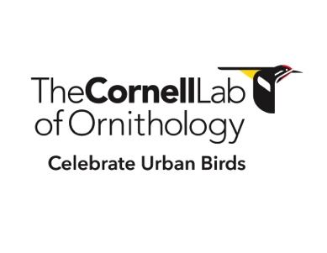
Thank you for sending us your observations!
Don’t forget to send your data even if you see NO Birds.
www.CelebrateUrbanBirds.org
Notes:
So now you can recognize some birds! Plan to go outside, note features of the area where you are doing the observation, like is there pavement, water, etc, then turn over the data sheet, start the clock, and just watch for 10 minutes! You can watch by yourself or have a whole group observe the same area at the same time. Mark down the results, send us the paper data sheet or load the results into our web site online! We love getting more observations! You can do more observations in the same location or observe in different locations! Thanks for helping us keep track of and Celebrate Urban Birds!

